Slide 1

Welcome to our
Information Evening
Fabulous Flamingos

Slide 2
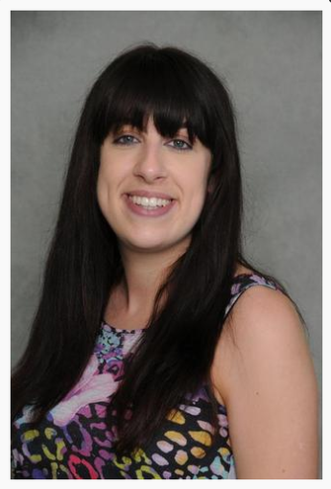
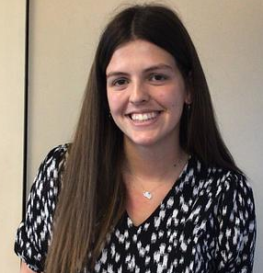
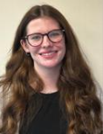
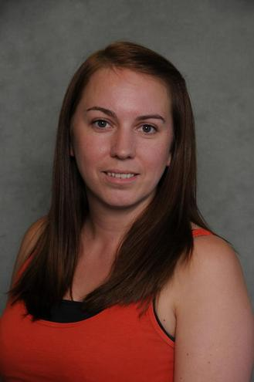
Introductions
Mrs Cowen
Class teacher
Monday-Thursday
Miss Maddock
Class teacher
Friday
Miss Cannell
Teaching assistant
Mrs Goetzee
Teaching assistant

Slide 3

End of Year Expectations
Betley CE
Primary School
End of Year Expectations
for Year 1 and 2

Slide 4
Writing
Year 1
Write clearly demarcated sentences.
Use ‘and’ to join ideas.
Use conjunctions to join sentences (e.g. so, but).
Use standard forms of verbs, e.g. go/went.
Introduce use of:
  capital letters
  full stops
  question marks
  exclamation marks
Use capital letters for names and personal pronoun ‘I’.
Write a sequence of sentences to form a short narrative [as introduction to paragraphs].
Use correct formation of lower case – finishing in right place.
Use correct formation of capital letters.
Use correct formation of digits.
Year 2
Write different kinds of sentence: statement, question, exclamation, command.
Use expanded noun phrases to add description and specification.
Write using subordination (when, if, that, because) and co-ordination (or, and, but).
Correct and consistent use of present tense & past tense.
Correct use of verb tenses.
Write with correct and consistent use of:
  capital letters
  full stops
  question marks
  exclamation marks
Use commas in a list.
Use apostrophe to mark omission and singular possession in nouns.
Write under headings.
Write lower case letters correct size relative to one another.
Show evidence of diagonal and horizontal strokes to join handwriting.

Slide 5

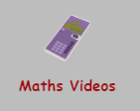

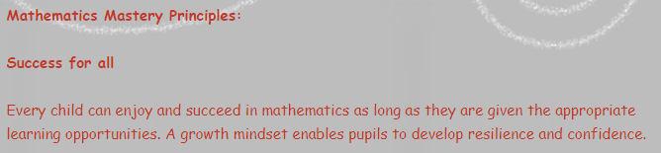
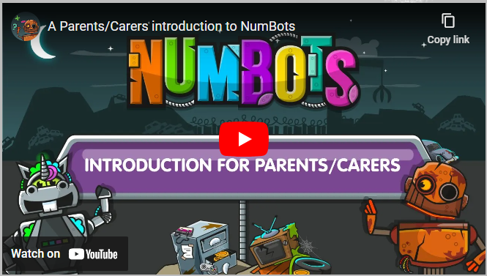
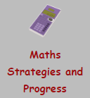

Slide 6
Maths
Year 1
Count to and across 100, forwards & backwards from any number.
Read and write numbers to 20 in numerals & words.
Read and write numbers to 100 in numerals.
Say 1 more/1 less to 100.
Count in multiples of 2, 5 & 10.
Use bonds and subtraction facts to 20.
Add & subtract 1 digit & 2 digit numbers to 20, including zero.
Solve one-step multiplication and division using objects, pictorial representation and arrays.
Recognise half and quarter of object, shape or quantity.
Sequence events in chronological order.
Use language of day, week, month and year.
Tell time to hour & half past.
each month and number of seconds in a minute.
Year 2
Compare and order numbers up to 100 and use < > =.
Read and write all numbers to 100 in digits & words.
Say 10 more/less than any number to 100.
Count in steps of 2, 3 & 5 from zero and in 10s from any number (forwards and backwards).
Recall and use multiplication & division facts for 2, 5 & 10 tables.
Recall and use +/- facts to 20.
Derive and use related facts to 100.
Recognise place value of any 2-digit number.
Add & subtract:
  2-digit nos & ones
  2-digit nos & tens
  Two 2-digit nos
  Three 1-digit nos
Recognise and use inverse (+/-).
Calculate and write multiplication & division calculations using multiplication tables.
Recognise, find, name and write 1/3; 1/4; 2/4; 3/4.
Write and recognise equivalence of simple fractions.
Tell time to five minutes, including quarter past/to.

Slide 7
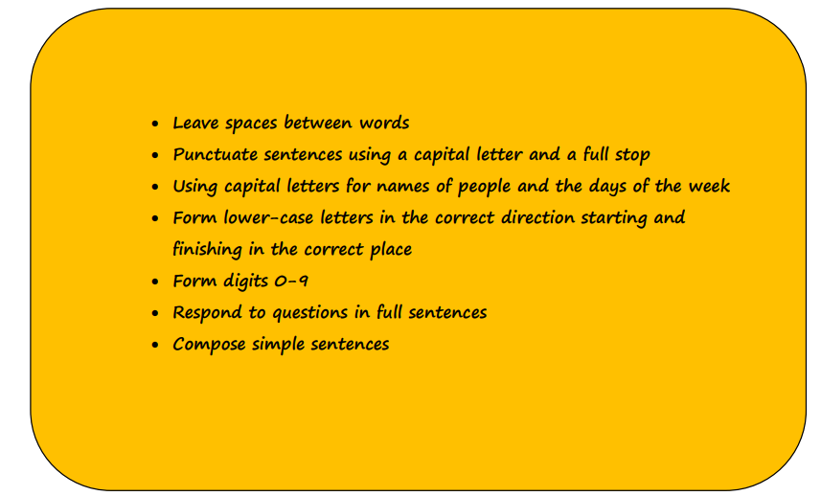
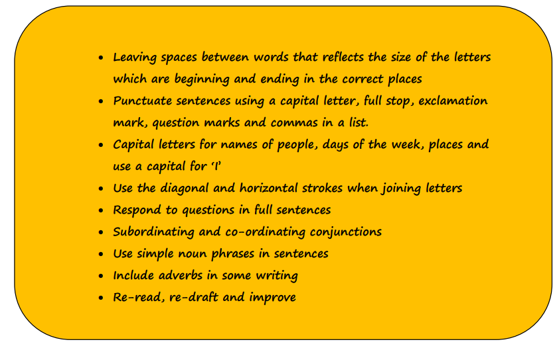
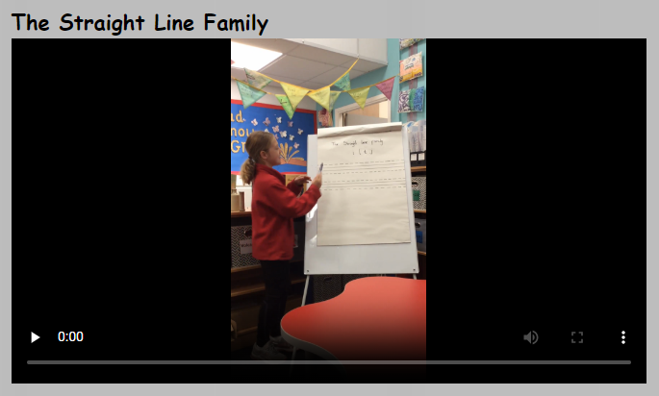

Slide 8
Reading
Year 1
Identify which words appear again and again.
Recognise and join in with predictable phrases.
Relate reading to own experiences.
Re-read if reading does not make sense.
Re-tell with considerable accuracy.
Discuss significance of title and events.
Make predictions on basis of what has been read.
Make inferences on basis of what is being said and done.
Read aloud with pace and expression, i.e. pause at full stop; raise voice for question.
Recognise:
  capital letters
  full stops
  question marks
  exclamation marks
  ellipsis
Know why the writer has used the above punctuation in a text.
Know difference between fiction and non-fiction texts.
Year 2
Secure with year group phonic expectations.
Recognise simple recurring literary language.
Read ahead to help with fluency and expression.
Comment on plot, setting & characters in familiar & unfamiliar stories.
Recount main themes and events.
Comment on structure of the text.
Use commas, question marks and exclamation marks to vary expression.
Read aloud with expression and intonation.
Recognise:
  commas in lists
  apostrophe of omission and possession (singular noun)
Identify past/present tense and why the writer has used a tense.
Use content and index to locate information.
https://www.betley.staffs.sch.uk/reading-at-home/

Slide 9

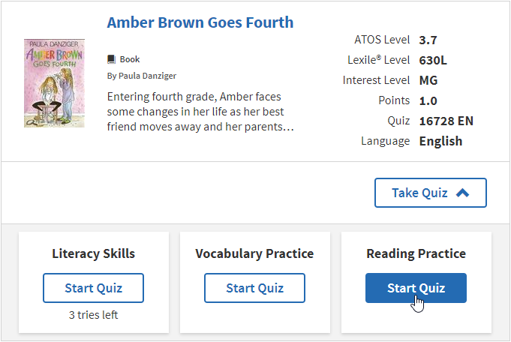

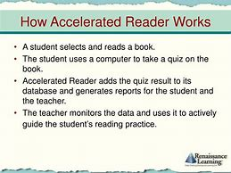

Slide 10

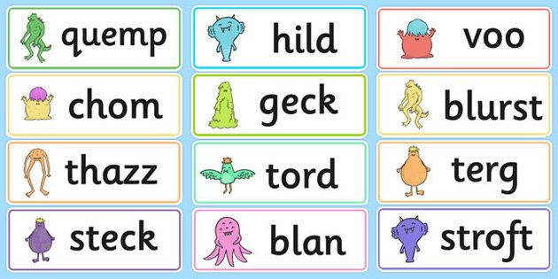
Phonics
Year 1 children have a statutory requirement to undertake the phonics screening. The screening takes place in mid June. This year: Wc Monday 9th June 2025
If your child does not pass the test in Year 1 they will retake the screen in Year 2.
In the screen there is a mixture of real and pseudo words which will be read using phonics.
shoy bake
phreep phone
sharl start

Slide 11
Phonics
At the end of Year 1 last year, your child should be secure at Phase 5.
Phase 5 builds upon previous learning and extends the range of graphemes children recognise. It also teaches alternative pronunciations of graphemes and spelling. In Year 2, we will be consolidating Phase 5 before moving onto Phase 6.
ay – play oy – toy wh – when ou – out
ie – tie ea – eat ir – girl aw – saw
ph – photo ew – new oe – toe ue – blue
au – Paul
Split diagraphs a-e – cake e-e – even i-e – bike
oe – rode u-e - flute

Slide 12

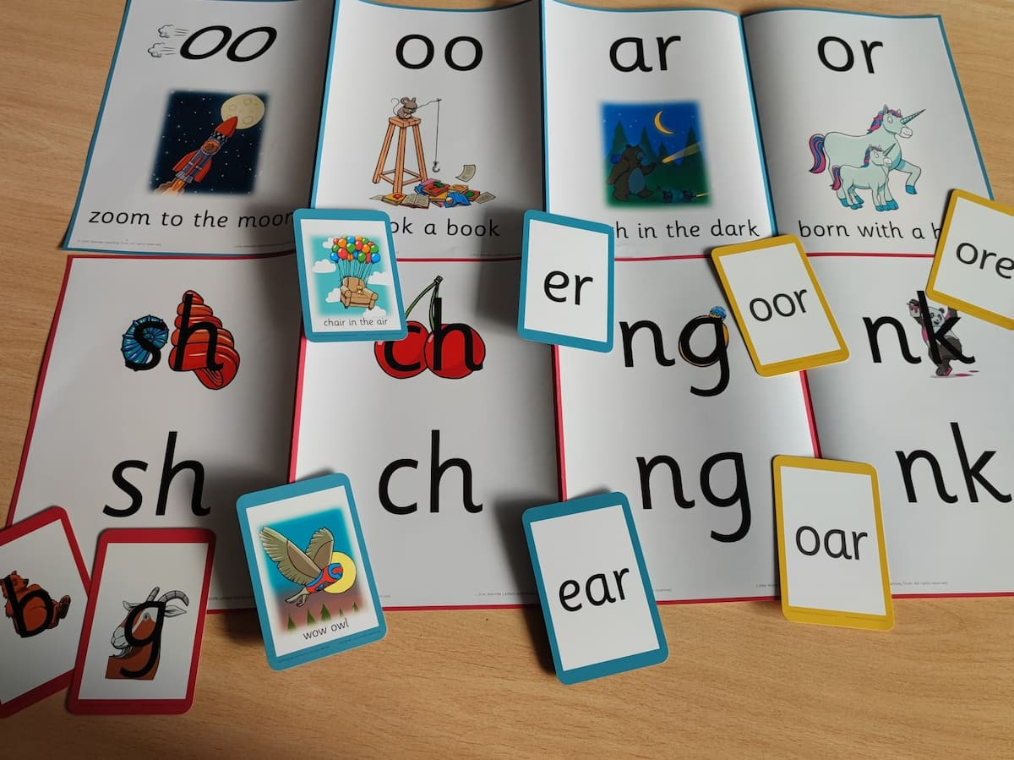
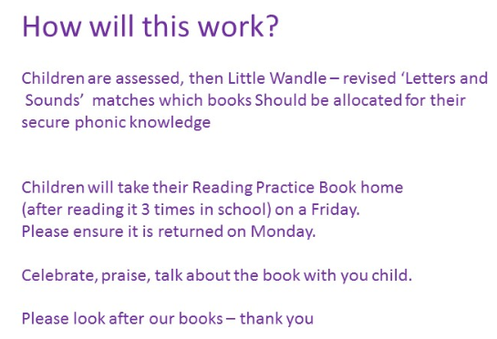

Slide 13
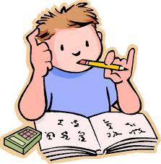
Homework- Don’t Worry!
Reading – at least 4 times a week (diaries and books need to be in school everyday) Diaries will be checked on a Thursday, if your child has read 4x they will be entered into a raffle to get a book from the vending machine.
Homework books – Given out on Friday (returned on Wednesday)
Weekly spelling sheets and a maths task/ literacy task (Year 2), phonics task (Year 1)

Slide 14
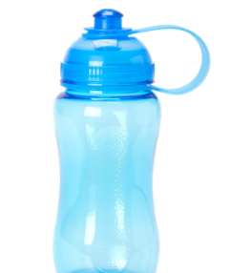
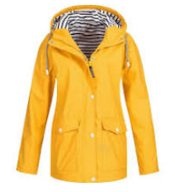
Extra Information
Please can you ensure your child brings a water bottle everyday.
Outdoor learning:
All children need to come to school in a waterproof coat for break times and outdoor learning.

Slide 15
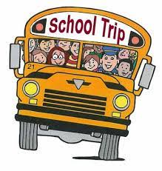
Trips
Children will attend at least one trip this year. Details of these trips along with the amount payable will be sent out at a later date.
Payment arrangements – Trips should be paid for online. If you wish to pay weekly, please speak to the office staff.

Slide 16
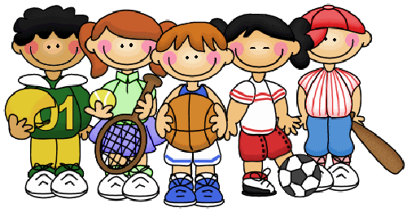
PE
PE kit
Plain red t-shirt, red hoodie
Plain black shorts or jogging bottoms
Trainers.
*Come to school in these on PE days (Tuesday and Wednesday)

Slide 17
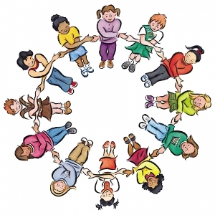
School Rules
Be Ready
Be Respectful
Be Safe

Slide 18
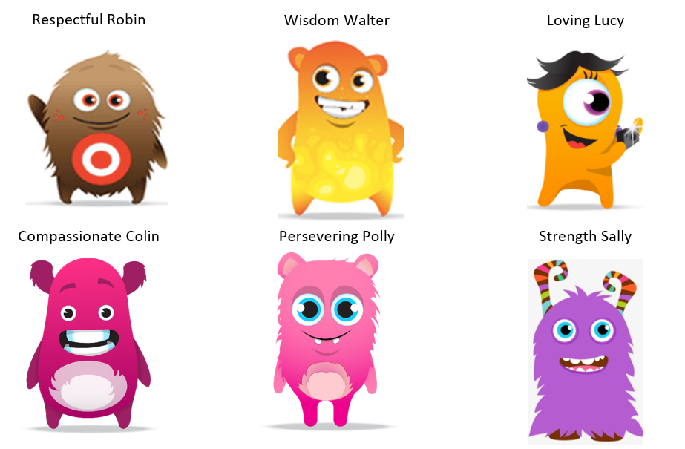
Dojo Characters based on School Values

Slide 19



Behaviour - Rewards
Dojos
Certificates/celebration
Worship

Slide 20

Pupil involvement
School council:
2 representatives from each class are elected by their peers to represent their class on the school council. The children attend meetings and meet with visitors (e.g. chair of governors) to ensure the opinions and the voice of our children in school is heard.
Class Ambassadors:
2 children from the class (1 from each year group) are selected by their peers to represent the class when visitors enter the classroom.
Reading ambassadors:
They meet to discuss how reading can be promoted through school.
Walking ambassadors:
Selected to promote walking to school or car pooling (when appropriate) in order to promote a positive carbon footprint.

Slide 21

Online Safety
Betley Primary School takes the online safety of children very seriously.
Our school systems mean that children are taught about the importance of Online Safety. We share an online newsletter each week.
Please ensure that you are monitoring your child’s access to the internet for their safety.
This includes the following:
Use of social media sites (Twitter, Facebook, Snapchat, Whatsapp, etc)
Suitability of games children are playing (their ratings)
Engagement with strangers via games (x box live etc)

Slide 22
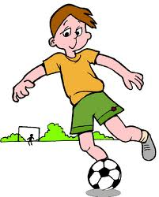

Clubs
We offer a wide range of clubs. These start this week and are advertised on Class Dojo as well as the school website.

