Slide 1

Welcome to our
Information Evening
Marvellous Minibeasts

Slide 2
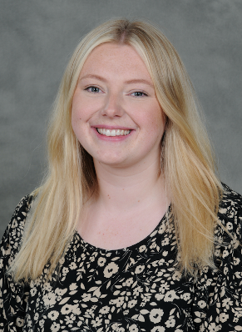
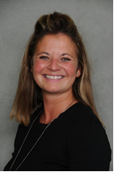
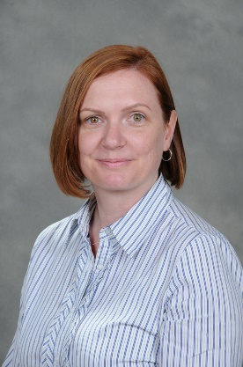
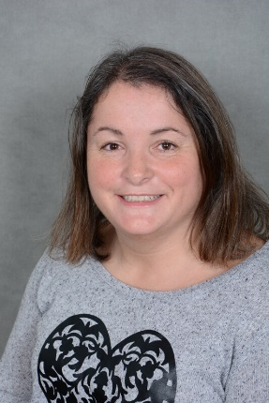
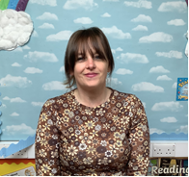
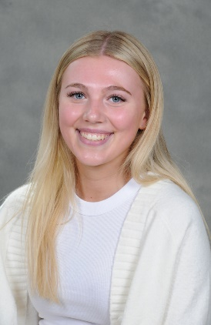
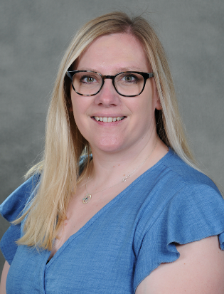
Introductions
Mrs Mutanda
Class Teacher
Mrs Whittingham
Head Teacher/EYFS Lead
Mrs Anderson
Teaching Assistant
Miss Ashbolt
Teaching Assistant
Mrs Shore
Teaching Assistant
Miss White
Teaching apprentice
Mrs Robinson
Teaching Assistant

Slide 3
Areas of Learning
Areas of learning we cover in Reception are
Communication and Language
Personal, Social and Emotional education
Physical development
Literacy
Maths
Understanding the World
Expressive Art and Design.
Within those areas there are many objectives to meet as we go through the year.
Phonics is a huge part of the reception curriculum and key to learning to read, write, spell and even speak correctly.

Slide 4
Phonics
We will be having our phonics sessions every morning. We will learn a new sound every day but revisit all previous sounds too.
We will learn to form each new letter correctly following the handwriting scheme used by all year groups in school.
Once we have built up several sounds, then we can move on to blending them together to read words. We use the same skills to start to build words to begin writing sentences.
Alongside daily phonics sessions the children will soon begin ‘practice read’ sessions 3 times a week in small groups

Slide 5
Phonics
Initially reading books coming home will just have pictures.
Use these to talk about what is happening in the picture – let the children identify, describe, use story language and predict what might happen next.
Gradually words, sentences will appear in their books, but we do not push this, and this will only happen when your child is ready for it.
This is when your child will be segmenting and blending sounds together to make words and to read captions and sentences.
Books are changed throughout the week, at least twice with book check being on Thursday, please make sure diaries are in!

Slide 6
Phonics
Assessment – we will assess phonics each half term to ensure your child is reading at the correct stage.
The assessment also checks their practice read groups are challenging them correctly.
We will complete daily catch up sessions if we recognise your child is not at the appropriate level during these assessments.

Slide 7


Homework
Reading – at least 3 times a week (diaries and books need to be in school everyday)
Spellings in Summer term.
We love to see and hear about anything you have done at home. Please fill in a star message for our ‘Good to be me’ board.

Slide 8
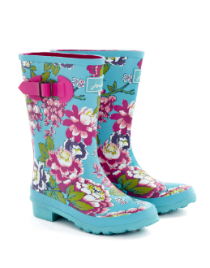

Extra Information
All children should have a water bottle in school every day.
Outdoor learning:
All children need to come to school in a waterproof coat for break times and outdoor learning.
Wellies can be left in school.
Snack
We gratefully ask for a contribution of £2 a week for school snack.
PE: Wednesday
Please can all children arrive to school wearing PE kit.

Slide 9

Trips
Children will attend at least one trip this year. Details of these trips along with the amount payable will be sent out at a later date.
Payment arrangements – Trips should be paid for online. If you wish to pay weekly, please speak to the office staff.

Slide 10
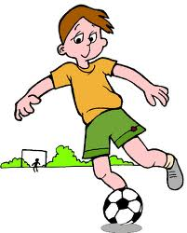

Clubs
Clubs start next week and if you would like your child to take part please ensure you have filled the appropriate forms via the school office.
An email went out last week – if you did not receive this, please speak to the school office.

Slide 11

Pupil involvement
School council:
2 representatives from each class are elected by their peers to represent their class on the school council. The children attend meetings and meet with visitors (e.g. chair of governors) to ensure the opinions and the voice of our children in school is heard.

Slide 12

School Rules
Be Ready
Be Respectful
Be Safe

Slide 13
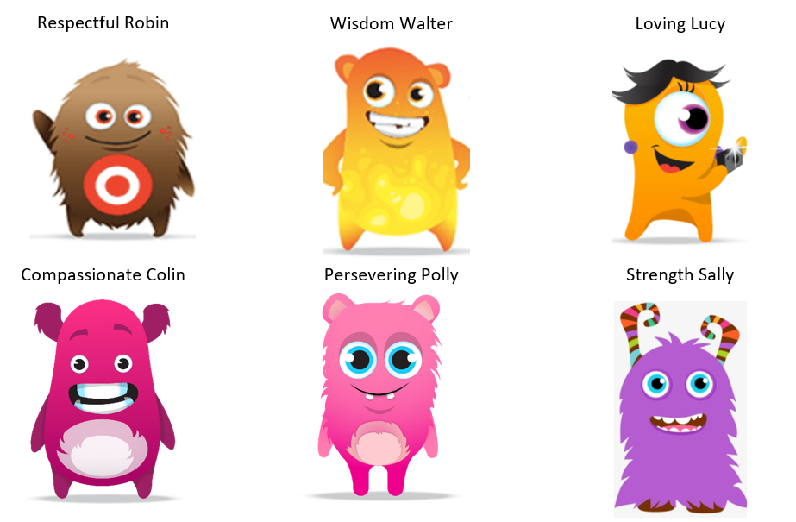
Dojo Characters based on School Values

Slide 14



Behaviour - Rewards
Dojos
Certificates/celebration
Worship

Slide 15

Online Safety
Betley takes the online safety of children very seriously.
Our school systems mean children are taught about the importance of Online Safety. We share an online newsletter each week.
Please ensure that you are monitoring your child’s access to the internet for their safety.
This includes the following:
Use of social media sites (Twitter, Facebook, Snapchat, Whatsapp, etc)
Suitability of games children are playing (their ratings)
Engagement with strangers via games (x box live etc)

Slide 16
Thank you!
We are all very excited to begin this learning journey with you and your children!
☺
Any Questions?

