Slide 1

Welcome to our
Information Evening
Perfect Penguins

Slide 2
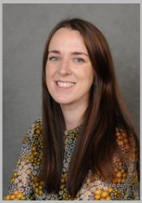
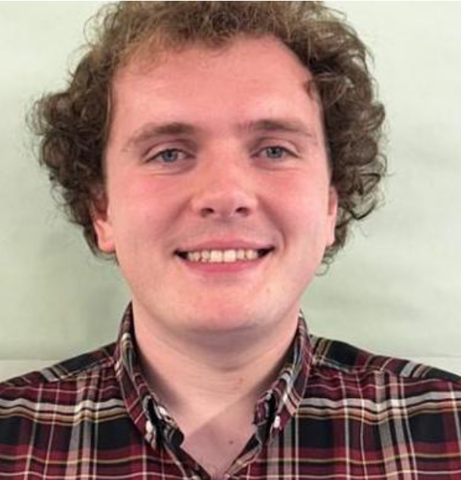
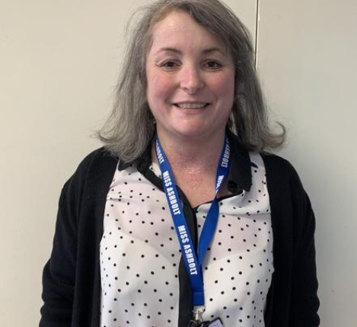
Introductions
Miss Ramsay
Mr Wood
Miss Ashbolt

Slide 3

End of Year Expectations
Betley CE
Primary School
End of Year Expectations
for Year 3 and 4

Slide 4
Reading
Year 3
Comment on the way characters relate to one another.
Know which words are essential in a sentence to retain meaning.
Draw inferences such as inferring characters’ feelings, thoughts and motives from their actions.
Recognise how commas are used to give more meaning.
Recognise inverted commas
Recognise:
  plurals
  pronouns and how used
  collective nouns
  adverbs
Explain the difference that the precise choice of adjectives and verbs make.
Year 4
Give a personal point of view on a text.
Re-explain a text with confidence.
Justify inferences with evidence, predicting what might happen from details stated or implied.
Use appropriate voices for characters within a story.
Recognise apostrophe of possession (plural)
Identify how sentence type can be changed by altering word order, tenses, adding/deleting words or amending punctuation.
Explain why a writer has used different sentence types or a particular word order and the effect it has created.
Skim & scan to locate information and/or answer a question.

Slide 5
Writing
Year 3
Use conjunctions (when, so, before, after, while, because).
Use adverbs (e.g. then, next, soon).
Use prepositions (e.g. before, after, during, in, because of).
Experiment with adjectives to create impact.
Correctly use verbs in 1st, 2nd and 3rd person.
Use perfect form of verbs to mark relationships of time and cause.
Use inverted commas to punctuate direct speech.
Group ideas into basic paragraphs.
Write under headings and sub-headings.
Write with increasing legibility, consistency and fluency.
Year 4
Vary sentence structure, using different openers.
Use adjectival phrases (e.g. biting cold wind).
Use appropriate choice of noun or pronoun.
Use fronted adverbials.
Use apostrophe for plural possession.
Use a comma after fronted adverbial (e.g. Later that day, I heard bad news.).
Use commas to mark clauses.
Use inverted commas and other punctuation to punctuate direct speech.
Use paragraphs to organised ideas around a theme.
Use connecting adverbs to link paragraphs.
Write with increasing legibility, consistency and fluency.

Slide 6
Maths
Year 3
Compare & order numbers up to 1000.
Read & write all numbers to 1000 in digits and words.
Find 10 or 100 more/less than a given number.
Count from 0 in multiples of 4, 8, 50 and 100.
Recall & use multiplication & division facts for 3, 4, 8 tables.
Recognise place value of any 3-digit number.
Add and subtract - 3-digit nos and ones, 3-digit nos and tens, 3-digit nos and hundreds
Add and subtract - Numbers with up to 3-digits using written columnar method.
Estimate and use inverse to check.
Multiply 2-digit by 1-digit
Count up/down in tenths.
Compare and order fractions with same denominator.
Add and subtract fractions with same denominator with whole.
Tell time using 12 and 24 hour clocks; and using Roman numerals.
Tell time to nearest minute.
Know number of days in each month and number of seconds in a minute.
Year 4
Count backwards through zero to include negative numbers.
Compare and order numbers beyond 1,000.
Compare and order numbers with up to 2 decimal places.
Read Roman numerals to 100.
Find 1,000 more/less than a given number.
Count in multiples of 6, 7, 9, 25 and 1000.
Recall and use multiplication and division facts all tables to 12x12.
Recognise PV of any 4-digit number.
Round any number to the nearest 10, 100 or 1,000.
Round decimals with 1dp to nearest whole number.
Add and subtract numbers with up to 4-digits using written columnar method.
Multiply:
  2-digit by 1-digit
  3-digit by 1-digit
Count up/down in hundredths.
Recognise and write equivalent fractions
Add and subtract fractions with same denominator.
Read, write and convert time between analogue and digital 12 and 24 hour clocks.

Slide 7

This term
English – Punctuation and grammar focus, embedding basic skills.
Maths – Place value and addition and subtraction. Please see the website for ways your can support with your child's learning.
Topics – Ancient Egypt

Slide 8
Homework
Reading – at least 4 times a week (diaries and books need to be in school everyday) Diaries will be checked on a Thursday and if your child has read 4x they will be entered into a raffle to win a book from the vending machine.
Homework books – Given out on Friday (returned on Wednesday)
Weekly spelling sheets (some spellings will cover 2 weeks!) and a maths task – sometimes on PurpleMash, this will depend on the topic.

Slide 9

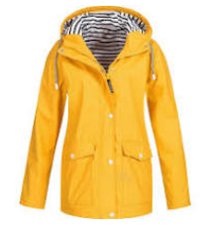
Extra Information
Please can you ensure your child brings a water bottle everyday – with their name on!
Outdoor learning:
All children need to come to school in a waterproof coat for break times and outdoor learning, when warmer please ensure they have a sun hat with them.
Forest School – Wellies, waterproofs, clothing you won’t mind getting a little muddy!

Slide 10

Trips
Children will attend at least one trip this year. Details of these trips along with the amount payable have been sent out at the end of last year.
Payment arrangements – Trips should be paid for online. If you wish to pay weekly, please speak to the office staff.

Slide 11
Lunches
Our school dinners are cooked on site, the cost is £3.20. Snacks are sold for playtime and ordered on a weekly basis.
If you are entitled to Free School Meals (FSM) funding you must complete the appropriate forms at the school office.

Slide 12

PE
PE kit
Plain red t-shirt
Plain black shorts or jogging bottoms
Trainers.
*Come to school in these on PE days – Tuesday and Wednesday

Slide 13

School Rules
Be Ready
Be Respectful
Be Safe

Slide 14
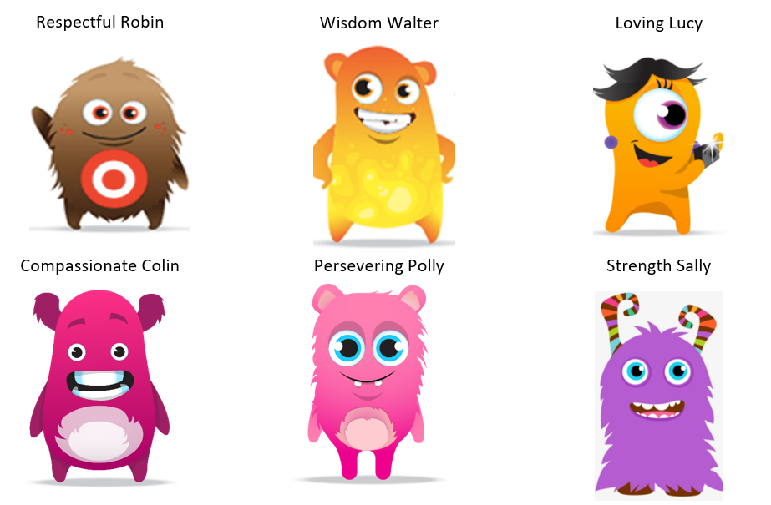
Dojo Characters based on School Values

Slide 15



Behaviour - Rewards
Dojos
Certificates/celebration
Worship

Slide 16

Pupil involvement
School council:
2 representatives from each class are elected by their peers to represent their class on the school council. The children attend meetings and meet with visitors (e.g. chair of governors) to ensure the opinions and the voice of our children in school is heard.

Slide 17

Online Safety
Betley Primary School takes the online safety of children very seriously.
Our school systems have children are taught about the importance of Online Safety. We share an online newsletter each week.
Please ensure that you are monitoring your child’s access to the internet for their safety.
This includes the following:
Use of social media sites (Twitter, Facebook, Snapchat, Whatsapp, etc)
Suitability of games children are playing (their ratings)
Engagement with strangers via games (x box live etc)

Slide 18
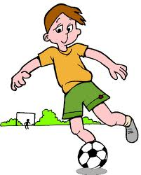

Clubs
We offer a wide range of clubs, including some with external providers.
Please see Class Dojo for updates.

