Slide 1

Welcome to our
Information Evening
Cheeky Chimps

Slide 2
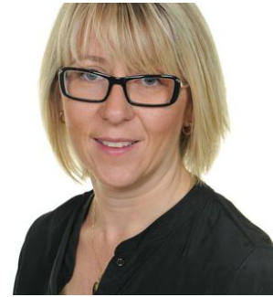
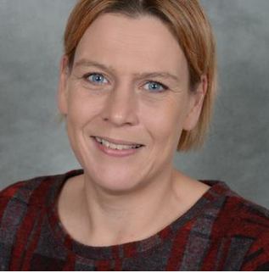
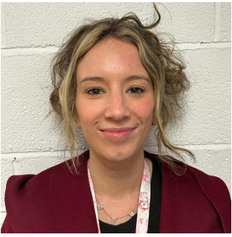
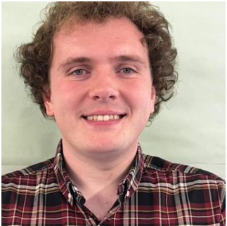
Introductions
Mrs King
Mrs Johnson
Miss Tully
Mr Wood

Slide 3

End of Year Expectations

Slide 4
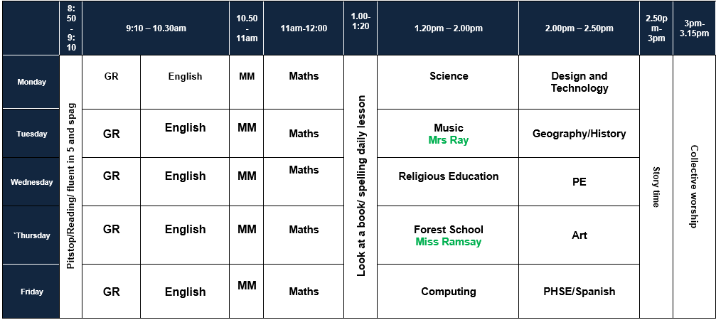

Slide 5

Homework
Reading – at least 4 times a week (diaries and books need to be in school everyday)
Homework books – Given out on Friday (returned on Wednesday)
Weekly spelling sheets – due to change in spelling scheme that follows morphology – some spellings sent home might be for two weeks but an fluency activity will be sent home on the second Friday for the children to practise.
Homework expectations – Maths basic skills and English activity each week .

Slide 6
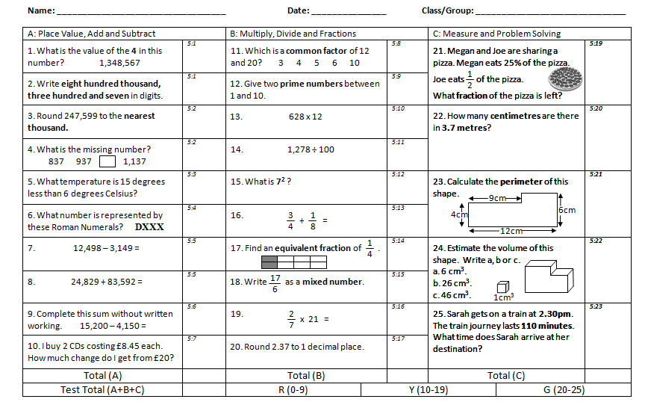

Slide 7
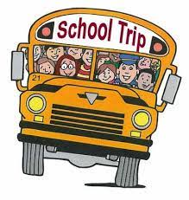
Trips
Children will attend at least one trip this year. Details of these trips along with the amount payable will be sent out at a later date.
Payment arrangements – Trips should be paid for online.
Stockport Air raid shelters- 26th January 2026
Maya Workshop – 10th March 2026

Slide 8

PE – this half term
PE days will be Wednesday and Thursday
Wednesday – Year 6 swimming and Year 5 PE.
Thursday – Forest School – clothes you don’t mind getting muddy and suitable footwear.
PE days will change each half term – but I will let you know at the beginning of each half term.

Slide 9

School Rules
Be Ready
Be Respectful
Be Safe

Slide 10
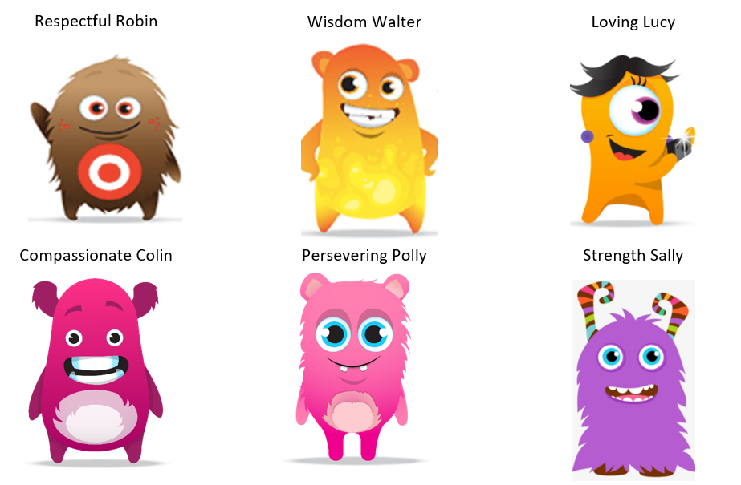
Dojo Characters based on School Values

Slide 11

Online Safety
Betley School takes the online safety of children very seriously.
Our school systems have children are taught about the importance of Online Safety. We share an online newsletter each week.
Please ensure that you are monitoring your child’s access to the internet for their safety.
This includes the following:
Use of social media sites (Twitter, Facebook, Snapchat, Whatsapp, etc)
Suitability of games children are playing (their ratings)
Engagement with strangers via games (x box live etc)

Slide 12

Pupil involvement
School council:
2 representatives from each class are elected by their peers to represent their class on the school council. The children attend meetings and meet with visitors (e.g. chair of governors) to ensure the opinions and the voice of our children in school is heard.
Class Ambassadors – greet our visitors in school and give a quick introduction to our class

Slide 13
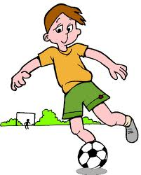

Reading
We use accelerated reader and star reader to track and assess the children’s progress in reading.
Once a child has read a book at home, please can they log in and complete the quiz on the book.
Children will come home with at least 2 books – one is in line with their ZPD range and one is a free read choice.
The ZPD ranges are calculated by accelerated reader once the children have completed a star reader assessment in school each half term. This is based on fluency, reading comprehension and language skills.

